Slide 1
Honors 9: Persepolis

Slide 2
Welcome Honors 9!
Do Now:
Get your folder from the student center
Have a seat.
Homework: outline due by the end of class on Wednesday, 3/22.
LEQs-- What is a thesis? How can we craft a literary thesis? How can we create an outline for a literary paper?

Slide 3
Brainstorming
Should have evidence of some thought towards answering prompt.

Slide 4
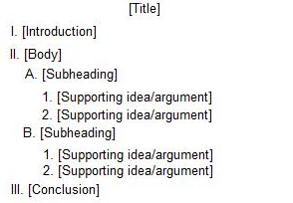
Outlines
What can we put in the intro?
All body paragraphs should relate to what?

Slide 5
What is a Thesis for a literary Paper?

Slide 6
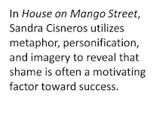
Think about your Theme essays:
Introduced text, author and argued towards a theme. All the evidence you provided in the body paragraphs contributed to what you established as the theme.
Other literary thesis examples:

Slide 8
Ways to Get started:
Satrapi's Persepolis shows how Marji's ever-changing world has an impact on her identity. Marji is most defined by.........
In Persepolis, Satrapi shows that Marji's self-definition evolves/ changes based on …...

Slide 9
During class....
Work on outline due at the end of class on Wed. 2/22.
Write out (tentative) thesis
Show how points in body paragraphs will be supported from the text/ graphics
See Class website, Honor 9 for help on thesis statements/ outline.

Slide 10
Rest of class:
Work on brainstorming an answer to the prompt.
Think of examples you remember most from the story.
Create a tentative thesis and write it on your brainstorming sheet.
Character Traits for Marji:
Curious, naïve, conflicted, blunt, impressionable, scared, truth-seeking, mature, immature, impulsive, intellectual, religious, rebellious, avant-garde, What else?

