Slide 1
Logical Fallacy Notes
Comp. & Rhet. ENG 1010

Slide 2
Day 10: Logical Fallacies
Warm Up: Read the following statement and discuss its logic at your table. Why doesn’t this work? Answer on this note sheet.
Smoking does not cause cancer because my grandfather smoked two packs a day for 50 years, and he died in his sleep at age 90.

Slide 3
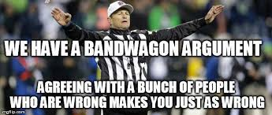
Fallacies of Pathos
What it is
Why It is Wrong
Argument to the People (Appealing to Stirring Symbols): using symbols to make people feel included
Appeal to Ignorance: asks an audience to believe a claim because it hasn’t been proved false or vice versa. (Ghosts must be real because you can’t prove they aren’t real.)
Bandwagon: The idea that something is right because it is popular.
Emotional or evocative symbols don’t make something right
The burden of proof is on proving something, not disproving it (innocent until proven guilty)
What is popular is not necessarily what is right!

Slide 4
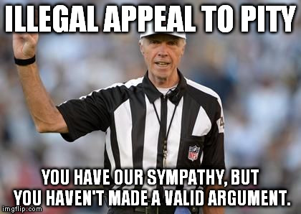
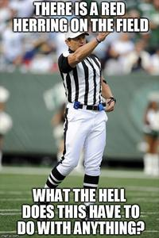
Fallacies of Pathos, Continued
What it is
Why It’s Wrong
Appeal to Pity: using pity to sway the audience to a cause
Red Herring: throwing an audience off of the correct track with a distraction
Evoking sympathy does not make the cause legitimate
What is the real issue?

Slide 5
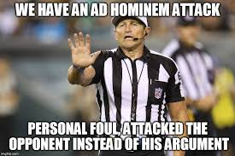
Fallacies of Ethos
What it is
Why it’s Wrong
Appeal to false Authority: using someone famous who really doesn’t know the issue
Ad Hominem: Latin for “to the man” It is a personal attack on the arguer instead of the argument
Poisoning the Well: discrediting an opponent before they have a chance to argue their claim
Straw Man: Takes a complex argument and reduces it to a simpler argument that is easier to knock down. It’s easier to defeat a strawman than a heavyweight champ.
Just being famous doesn’t make someone an expert
It is a distraction from the real argument
Creates an unfair bias for the audience
It mischaracterizes the opponent’s argument

Slide 6
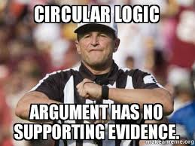
Fallacies of Logos
What it is
Why It’s Wrong
Hasty Generalization: a broad generalization based on little evidence
Part for the Whole: Arguing that one part represents the whole
Post Hoc, Ergo Propter Hoc: Saying that because something happened after an event, that the event caused the event
Begging the Question/Circular Reasoning: Using a reason to restate the claim
There must be a sufficient amount of evidence to prove a fact.
Choosing one part does not necessarily represent the whole
Sometimes things happen that aren’t tied to the events before them
Just re-wording the claim doesn’t make it evidence

Slide 7
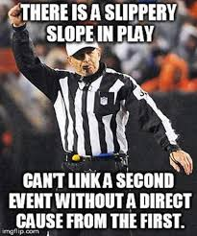
Fallacies of Logos, Continued
What it is
Why It’s Wrong
False Dilemma: Oversimplifying a complex argument so that it only has two sides or two resolutions, when really there are more
Slippery Slope: the idea that one event will always lead to an extreme event later on
False Analogy: Comparing two things that really aren’t in the same category
Distorting the truth in favor of an unreasonable answer
One action does not always lead to the worst possible outcome
It leads an audience to a false conclusion.

Slide 8
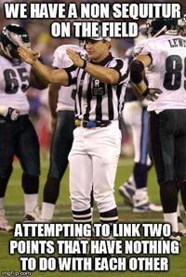
Fallacies of Logic, Continued
What it is
Why it’s wrong
Non Sequitur: Latin for “does not follow”. It makes an illogical leap from a claim to a conclusion
Loaded Label: renaming part of an argument with a word or name that has a negative connotation
There needs to be reasons and evidence to support a claim
This is an attempt to distract from the real argument with emotional language.

Slide 9
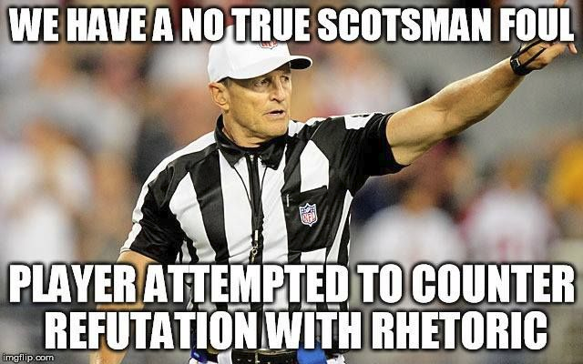
Some other Fallacies
What it Is
Why It’s Wrong
Middle Ground: the idea that the right answer is somewhere in between two points of view
No True Scotsman: the idea that a true Scotsman (or any other group) wouldn’t make that argument, so therefore, the speaker is not a true Scotsman.
Sometimes, one side is just right, and to meet in the middle is still wrong
Groups are not monolithic. Individuals can have different opinions and still be part of the group.

Slide 10
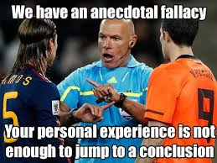
Some Other Fallacies
What It Is
What It’s Not
Anecdote Fallacy: Using an isolated incident instead of better evidence to generalize
The fallacy fallacy: Just because an argument involves what on the surface is a logical fallacy, doesn’t necessarily mean the whole argument is wrong.
One example is not sufficient for proof for a large group
Some arguments involve a logical fallacy and are in fact true.

