Slide 1
Evaluation Argument Notes
Comp. & Rhet. 2017

Slide 2
Day 2:
Review at your table:
What are the two types of evaluation arguments?
What steps do you follow for each?

Slide 3
Problem #1: The problem of standards
What is commonplace versus what is ideal?
Is it fair that you get a ticket for going 60 (commonplace) in a 55 (ideal)?
Is it right for parents to serve alcohol to their minor children and their friends because they will drink anyway (commonplace), even though 21 is the drinking age (ideal)?

Slide 4
Problem #2: Mitigating circumstances
An argument that unusual circumstances should change our normal standard of judgment.
For example: Late works loses points. HOWEVER, what if the student has a newborn baby that was sick?
If you are arguing for mitigating circumstances, there should be extra proof.

Slide 5
Problem #3: Choosing between two good or two bad situations
Sometimes an evaluation of a situation leads to two bad situations or two good situations. The criteria used leads to similar results.
Examples:
Should we cut pay or cut staff?
You got accepted to all five colleges you applied for. Now what?

Slide 6
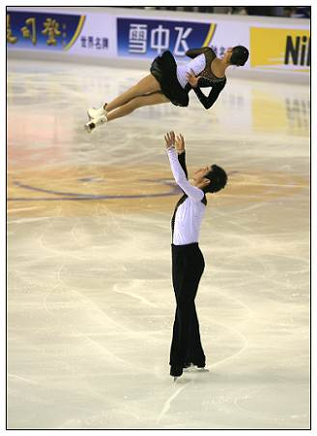
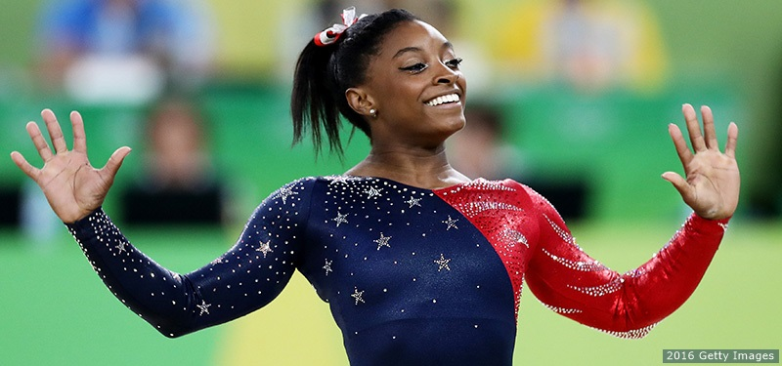
Problem #4: seductive empirical measures
When trying to evaluate something subjective, people create or use objective measures to try to make an unbiased evaluation. The problem is that these measures can leave out unquantifiable details.
For example:
Assessing teachers only based on their students’ standardized test scores
Only using SAT scores and GPA to determine who is accepted to college
Using combined scores in artistic sports like gymnastics or figure skating

Slide 7
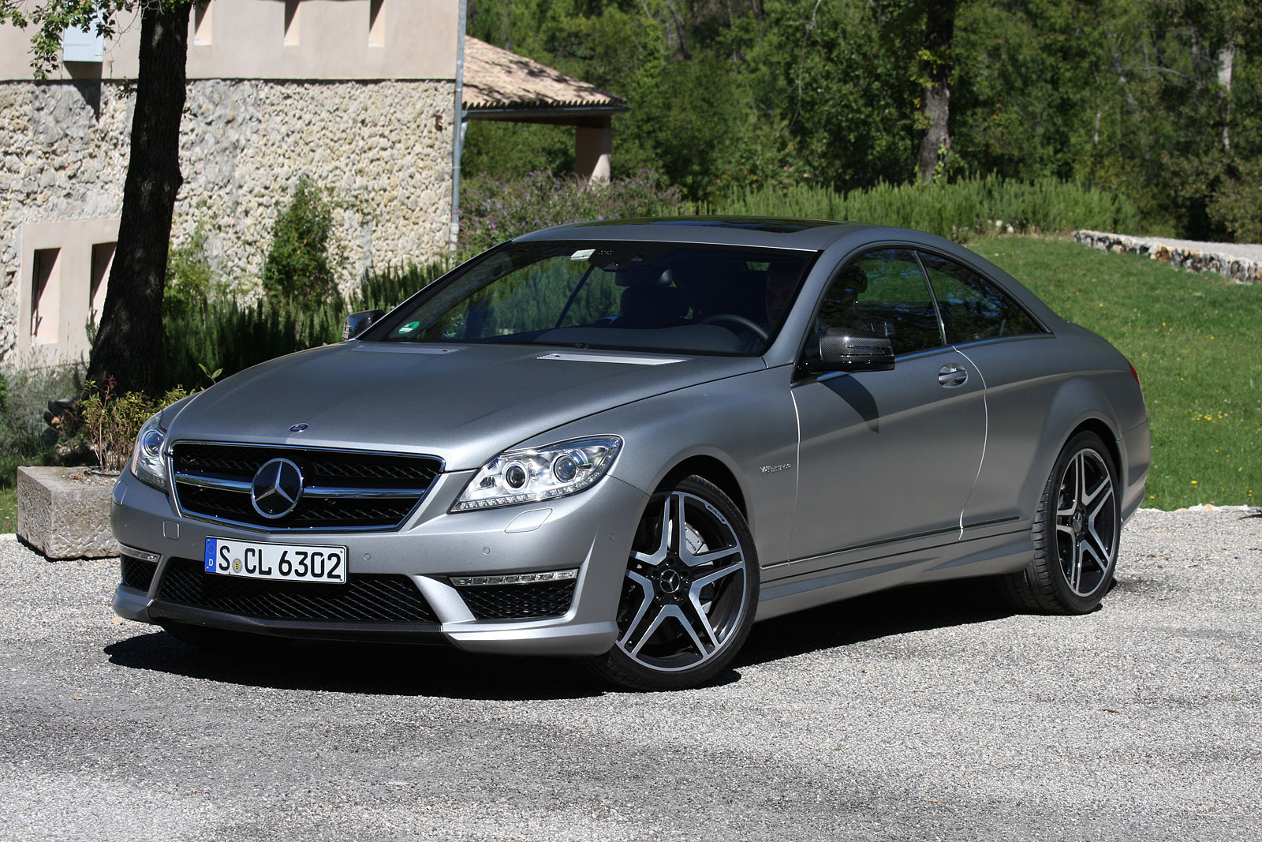
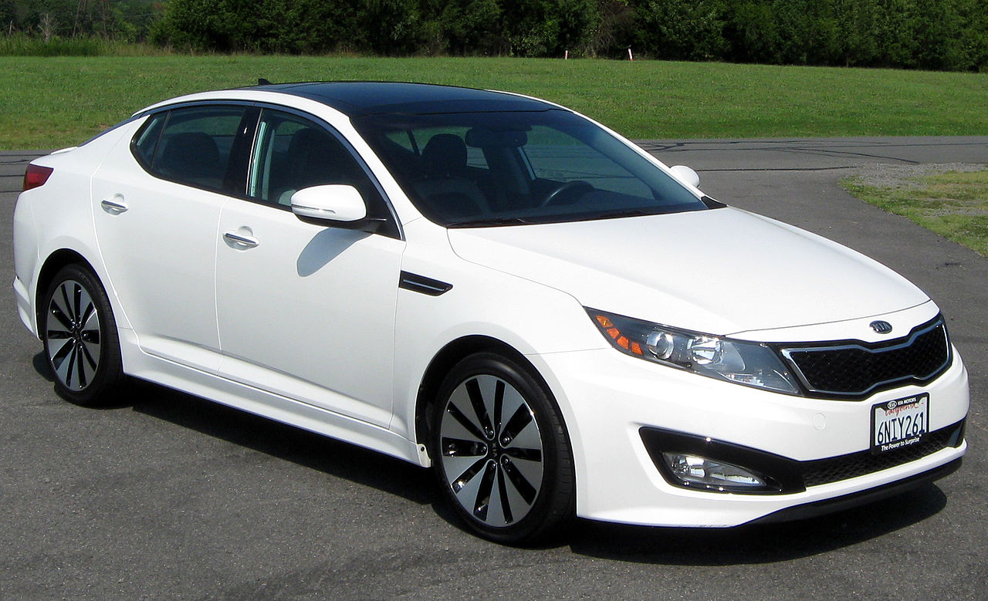
Problem #5: Cost
The best item in a given class is often the most expensive item in a given class.
Example: Don’t compare a Mercedes and a Kia. Compare a Mercedes and a BMW, and Kia and a Hyundai.

Slide 8
Organizing an evaluation argument
Turn in your book to page 292

Slide 9
sample
Choose to read either “Silenced and Invisible: Problems of Hispanic Students at Valley High School” page 294 or “Information Plus Satire: Why The Daily Show and The Colbert Report Are Good Sources of News for Young People” page 297.
Answer the questions that follow the essay on a separate sheet of paper. Include name, period and complete sentences.

