Slide 1
Comp. & Rhet. 12: Compare Contrast Essay

Slide 2
Comp. & Rhet.: Welcome!
Do Now:
Take your folder and a packet from the student center.
Have a seat. Take out venn diagrams from yesterday.
Homework: College Essay Revisions due Friday, 10/ 28
EQ: What are the components of a compare and contrast essay? What is the organization of a compare / contrast essay?

Slide 3
Song Compare/ Contrast
Label: Instrumental or Vocal.
Label one side of the venn diagram "A." Label the other side "B."
Listen to the selections. Make notes. Write down similarities in the middle, differences on either side.
Instrumental: http://viewpure.com/9Qv8ks7tyok?start=0&end=0 http://viewpure.com/TixYzh9qc44?start=0&end=0
Vocals: http://viewpure.com/e0q3lby5bDQ?start=0&end=0 http://viewpure.com/8ejeEBlDESc?start=0&end=0
Think: Instruments, vocals, tone/ mood, speed, audience, etc.

Slide 4
Packet example Paragraph
1: What is the point/ two things being compared/ contrasted?
2: What is the purpose of the paragraph?
3: What are the parallel points?
4: Are they in a logical order?

Slide 5
Compare/ Contrast Organization
Point-by-Point
Whole to whole
(see apples and oranges example)

Slide 6
Your Turn:
In groups, choose one of your venn diagrams: music genres, songs with vocals, instrumental songs
Create a whole to whole or point by point outline for what you have.
Put your rough outline on paper. Be prepared to share.

Slide 7
Comp. & Rhet.: Welcome!
Do Now:
Take your folder and a handout from the student center. Turn in Illustrative paragraph (late) if you haven't already.
Have a seat. Review for Grammar Quiz
Homework: College Essay Revisions due Friday, 10/ 28
EQ: How can I demonstrate my knowledge of fragments, run-ons, comma splices, comma usage, conjunctions and consistent person? What does it mean to compare and contrast?
What is the difference between a topic sentence and thesis?

Slide 8
Quiz Protocol:
No talking, electronic devices or nonverbal communication
All grammar materials must not be visible.
Please keep the above rules until all are done with the quiz.
If you have a question, raise your hand.
Turn over your papers and I will collect them.
On your handout, on the "Genre" side, begin to compare/ contrast two genres with the venn diagram.

Slide 9
Thesis vs. Topic Sentence
What is the thesis? Where is it located?
What are topic sentences? Where are they located?
http://viewpure.com/Nx2-PcBzZjo?start=0&end=0
jeopardylabs.com/play/grammar-jeopardy587

Slide 10
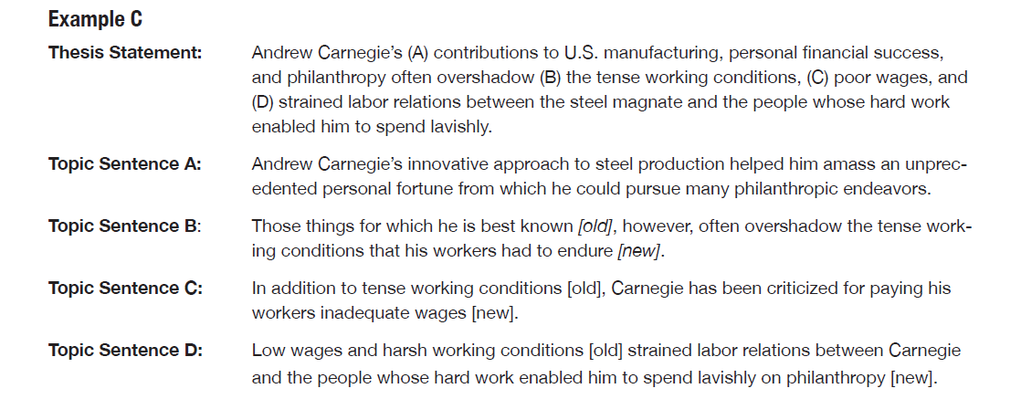
Thesis, Topic Sentence Match

Slide 12
Song Compare/ Contrast
Label: Instrumental or Vocal.
Label one side of the venn diagram "A." Label the other side "B."
Listen to the selections. Make notes. Write down similarities in the middle, differences on either side.
Instrumental: http://viewpure.com/9Qv8ks7tyok?start=0&end=0 http://viewpure.com/TixYzh9qc44?start=0&end=0
Vocals: http://viewpure.com/e0q3lby5bDQ?start=0&end=0 http://viewpure.com/8ejeEBlDESc?start=0&end=0
Think: Instruments, vocals, tone/ mood, speed, audience, etc.

Slide 13
Song Venn Diagram
Share your venn diagrams. Jot down any notes you may have missed. Be prepared to share.

Slide 14
Comp. & Rhet.: Welcome!
Do Now:
Take your folder and a notecard from the student center. Turn in Illustrative paragraph (late) if you haven't already.
Have a seat. Put your name and period on the notecard.
Homework: Study for Grammar Quiz
EQ: How can I demonstrate my knowledge of fragments, run-ons, comma splices, comma usage, conjunctions and consistent person?
What is the difference between a topic sentence and thesis?

Slide 15
This Week:
Today: Thesis vs. Topic sentence, Grammar review
Tuesday: Grammar Quiz, Compare/ Contrast Essay Intro
Wednesday: Compare/ Contrast examples, brainstorming
Thursday: Compare/ Contrast Outline
Friday: Compare/ Contrast Drafting (due 10/31)

